Slide 1
AGILERS
ALEX GABRIEL ILL LEET EXPENSE REIMBURSEMENT SYSTEM
Engineered By Alex Johnson AND GABRIEL ZAPATA

Slide 2
User Stories
Login
Register
Employee:
View their reimbursement requests
Submit new request
Manager:
View all employee requests
Submit new request
Approve/deny requests
Filter requests by status

Slide 3

Target Market
Revature
and Revature ONLY
Adopt us over your current ERS solution!

Slide 4
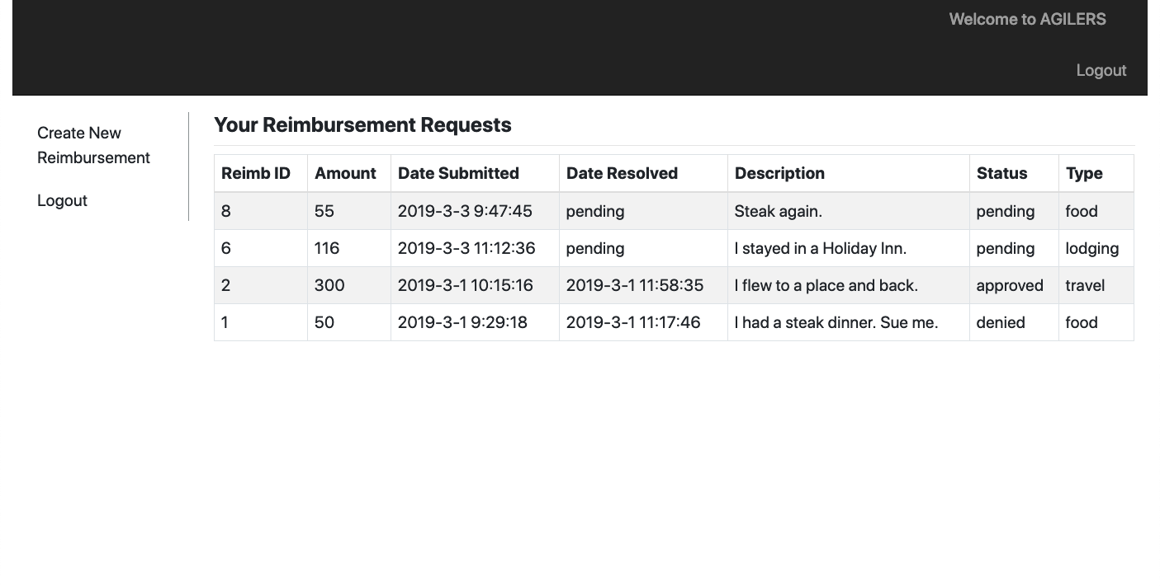
Why Agilers?
Most efficient
Most aesthetically pleasing layout and design
The illest, leetest ERS solution on the market

Slide 5
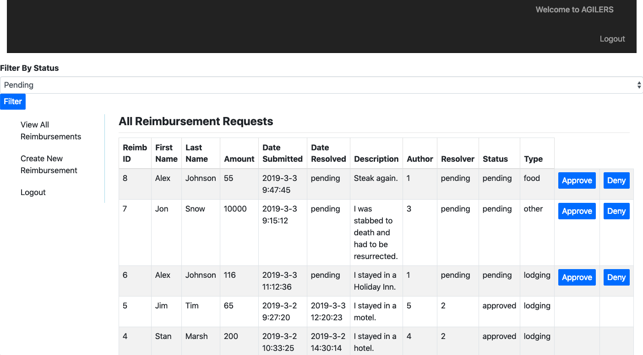
Now For A Site Demonstration…

Slide 6
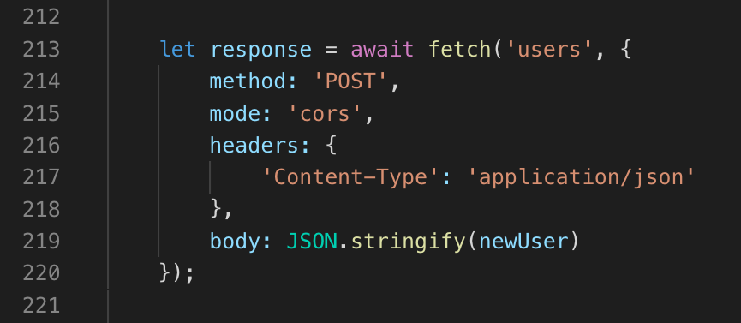
Sample Code: Check For Duplicate Username
Context: in async function register()
newUser has been built using user registration input
Attempt to add newUser to DB using a POST request

Slide 7
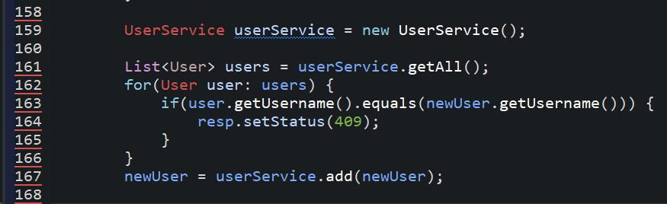
Sample Code: Check For Duplicate Username
Context: in UserServlet doPost() method
Grab all users
If username of newUser matches that of an existing user, send a client-side error in the response

Slide 8
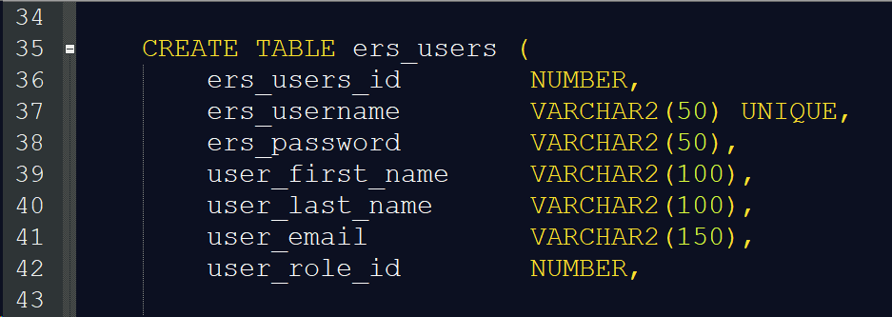
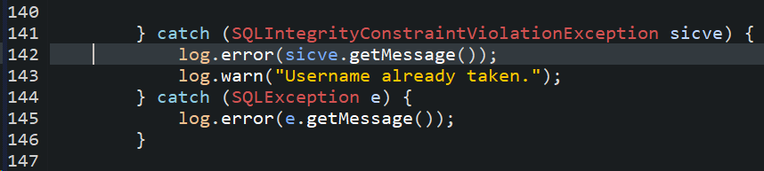
Sample Code: Check For Duplicate Username
Context: DB table creation script
UNIQUE constraint on ers_username
Context: in add() method of UserDAO
newUser will not be persisted to DB because sicve is thrown

Slide 9
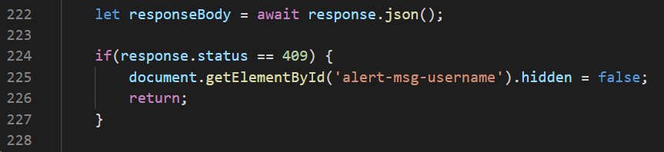
Sample Code: Check For Duplicate Username
Context: in async function register()
If the user receives the client-side error in question, display an alert message

Slide 10
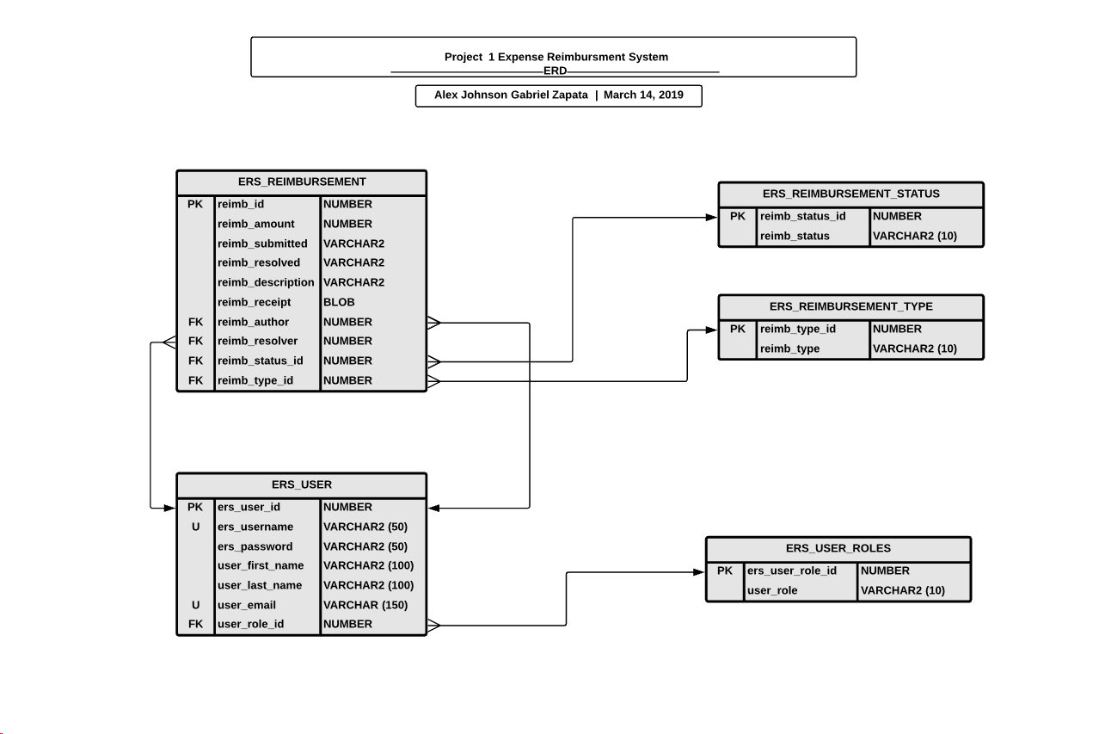

Slide 11
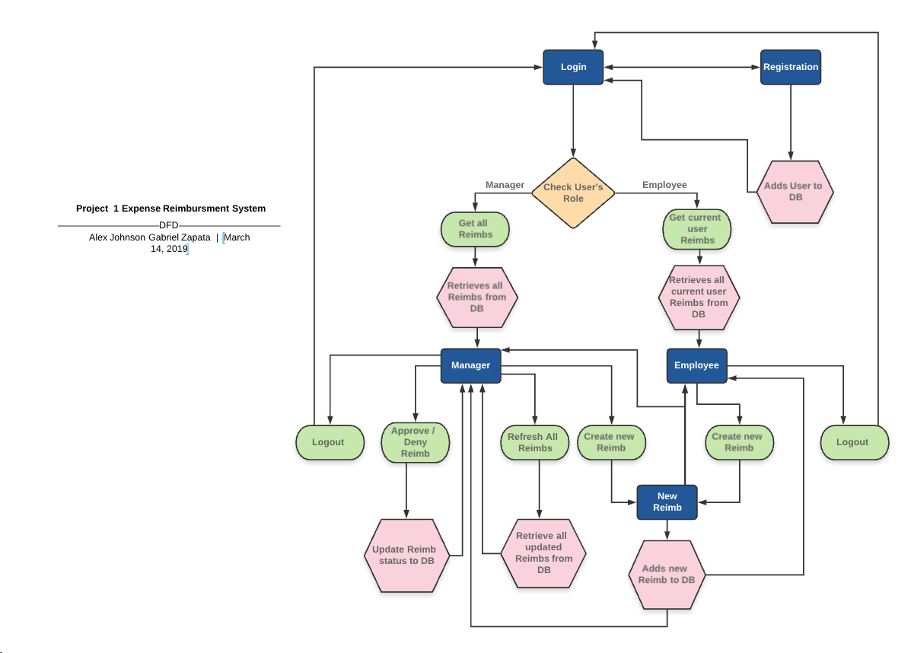

Slide 12
Thank you for your time! Any Questions? AGILERS
Engineered By Alex Johnson AND GABRIEL ZAPATA

